Slide 1
Multi-Criteria Dimensionality Reduction with Applications to Fairness
Uthaipon (Tao) Tantipongpipat
(graduating) PhD student, industry job market
Georgia Institute of Technology
Joint work with
Jamie Morgernstern, Samira Samadi, Mohit Singh, and Santosh Vempala

Slide 2
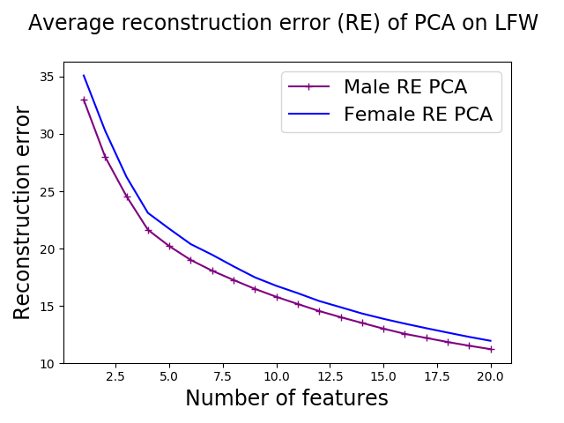
PCA can be unfair!
Standard PCA on face data LFW of male and female
Notes:
However, this widely-used PCA can give different performance to different subgroups in the data. We perform standard PCA on face images data from thousand of dimensions to between 1 and 20 dimensions. We observe that PCA represents male population about 10% consistently better than female population.

Slide 3
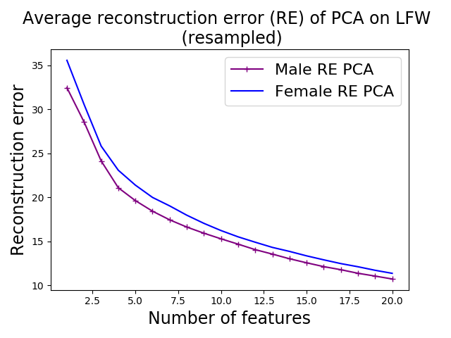
PCA can be unfair!
Standard PCA on face data LFW of male and female
Equalizing male and female weight before PCA
Notes:
The same observation is true even when we reweight each population to have equal weights. This is concerning because projected data are later used in machine learning algorithms to make prediction and decisions, and unfairness may already be introduced at this point.

Slide 4

Contribution 1: Problem Formulation
Multi-criteria dimensionality reduction (MCDR):
Utility criterion $f_{i}$’s and social welfare $g$

Slide 5
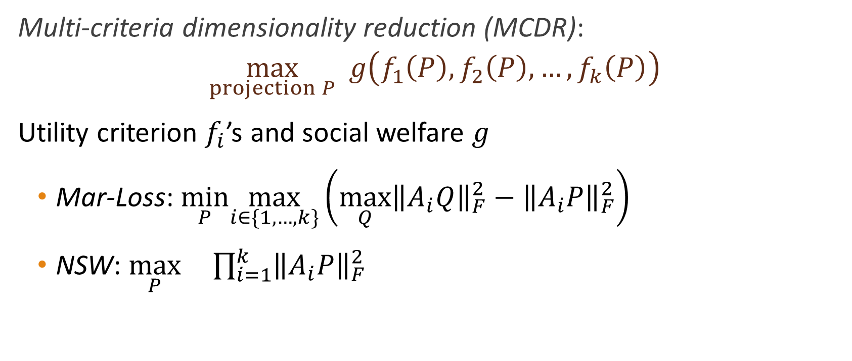
Contribution 1: Problem Formulation
Multi-criteria dimensionality reduction (MCDR):
Utility criterion $f_{i}$’s and social welfare $g$
Mar-Loss: $\min_{P}\max_{i∈\{1,…,k\}}\left(\max_{Q}{{\left\|A_{i}Q\right\|}_{F}^{2}}−{\left\|A_{i}P\right\|}_{F}^{2}\right)$
NSW: $\max_{P} \prod_{i=1}^{k}{{\left\|A_{i}P\right\|}_{F}^{2}}$

Slide 6

Contribution 2: Algorithms and Guarantees
On linear $f_{i}$ in $PP^{T}$ and concave $g$:
Polynomial-time algorithm for MCDR with optimal utility and small rank violation $s=\sqrt{2k+1/4}−3/2$
Approximation ratio $1−s/d$ on utility when no rank violation

Slide 7
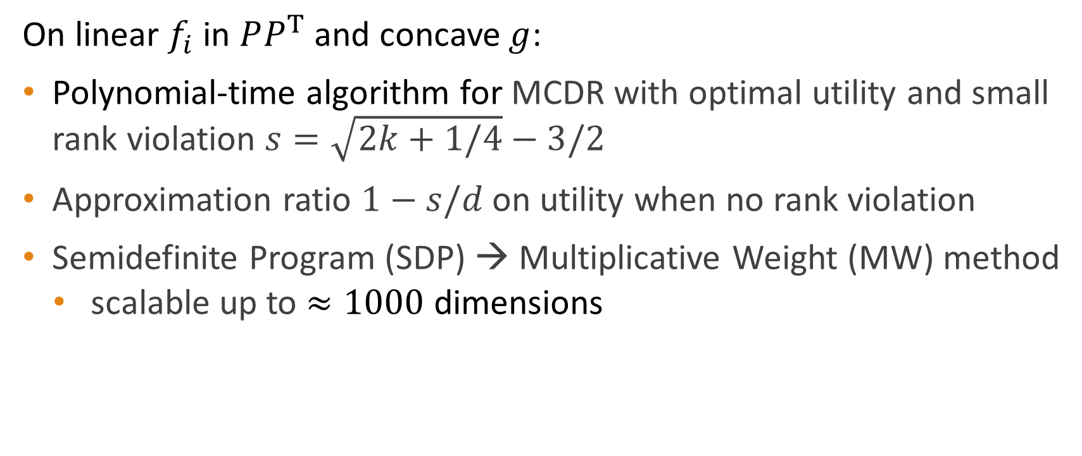
Contribution 2: Algorithms and Guarantees
On linear $f_{i}$ in $PP^{T}$ and concave $g$:
Polynomial-time algorithm for MCDR with optimal utility and small rank violation $s=\sqrt{2k+1/4}−3/2$
Approximation ratio $1−s/d$ on utility when no rank violation
Semidefinite Program (SDP) → Multiplicative Weight (MW) method
scalable up to $≈1000$ dimensions

Slide 8
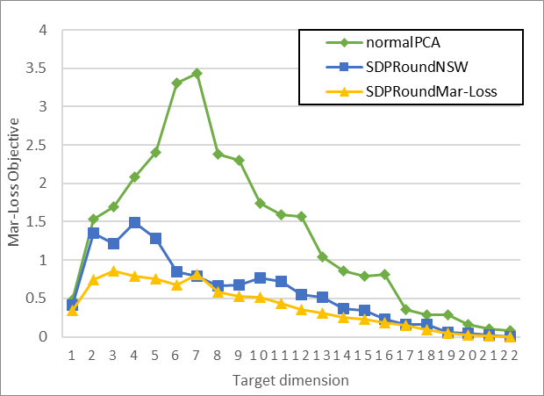
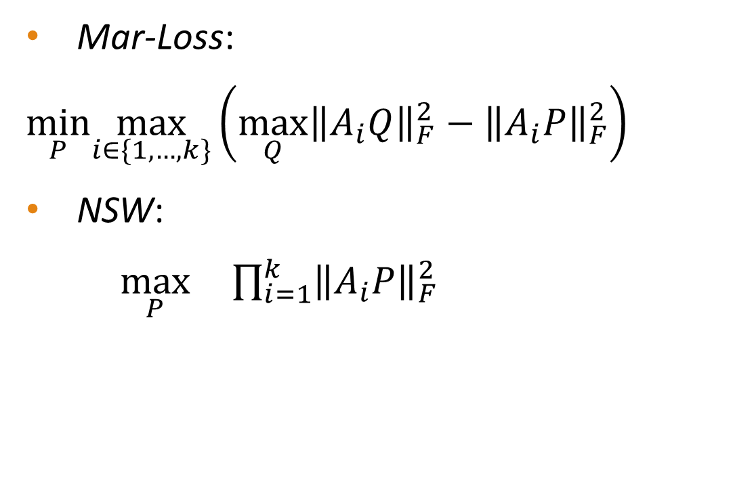
Contribution 2: Algorithms and Guarantees
Mar-Loss:
$\min_{P}\max_{i∈\{1,…,k\}}\left(\max_{Q}{{\left\|A_{i}Q\right\|}_{F}^{2}}−{\left\|A_{i}P\right\|}_{F}^{2}\right)$
NSW:
$\max_{P} \prod_{i=1}^{k}{{\left\|A_{i}P\right\|}_{F}^{2}}$

Slide 9
Contribution 3: Optimization Theory
Every extreme point of the semi-definite program relaxation of MCDR has low rank
Generalize work on low-rank property in semi-definite program by Barvinok’95, Pataki’98
Optimization result + ML application

Slide 10
Contribution 4: Complexity of MCDR
NP-hard for general 𝑘
Reduction to MAX-CUT
Polynomial-time for fixed 𝑘
Algorithmic theory of quadratic maps.

Slide 11
More details
Poster: Thursday Dec 12th at 10:45 AM -- 12:45 PM, East Exhibition Hall B + C #80
Happy to chat!
Code: github.com/uthaipon/multi-criteria-dimensionality-reduction
Web: sites.google.com/site/ssamadi/fair-pca-homepage
(searchable links at NeurIPS website or my website Uthaipon Tantipongpipat)

